Slide 1
Agenda 9/13
Questions?
MS Teams
P5.js
rotate, translate, pop, push
for loops
In-class exercise #3

Slide 2
p5.js recap
setup() vs draw()
Commands ( aka functions): Have arguments or parameter that goes between parenthesis
E.g. circle(100,100,40)
Syntax
{ } : Curly brackets define a chuck of code that belong in the same function.
In the p5.js web-editor, correct commands will become bold

Slide 3
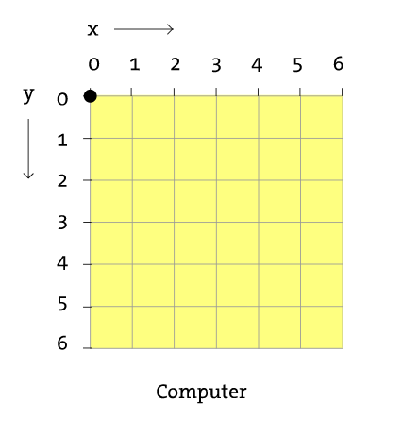
p5.js Canvas | Grid system
Pixels
createCanvas(500, 700);
This will create a canvas that is
500 pixels wide and 700 pixel high

Slide 4
p5.js rotate
rotate(angle) uses radian but can be used to degrees by using angleMode(DEGREES) before rotate
rotate(angle) is a little tricky as it rotates the entire canvas
To use it correctly you must first move the origin to the shape you are trying to rotate with the translate(x,y)
Since rotate(angle) will rotate the entire canvas you should use these commands between push() & pop()

Slide 5
p5.js variables
Variables are names that hold values
There are 2 types:
Built in variables
E.g. width & height
The ones you create
E.g. let squareSize = 55
Variable are helpful because:
Allows you to change your program dynamically
You can do math with them!

Slide 6
p5.js variables
Possible operations:
Addition (+), Subtraction, (-), Multiplication (*), Division(/)
Work on with both numbers and variable
xLocation = 14 * 10
xLocation = yLocation + 15
xLocation = yLocation / shapeSize
Comparison
Less than(<), Greater than (>)

Slide 7


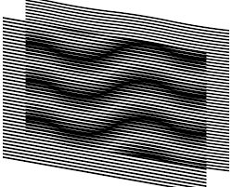
Try making this…
…with variables.
Line Moiré

Slide 8
p5.js loops
Much easier way to make with lesser code

Slide 9
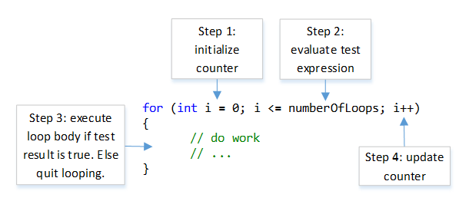
p5.js loops
loops are basically counters

Slide 10
Let’s try again with loops
Line Moiré

Slide 11
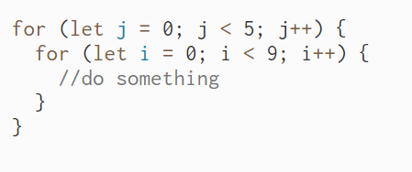
p5.js loops
Nested loops -> loop within loop
Really good for grid patterns

Slide 12
p5.js randomness
random([min], [max]) -> this will give you a random number between min and max-1
Great for creating Generative Forms that have more* character

Slide 13
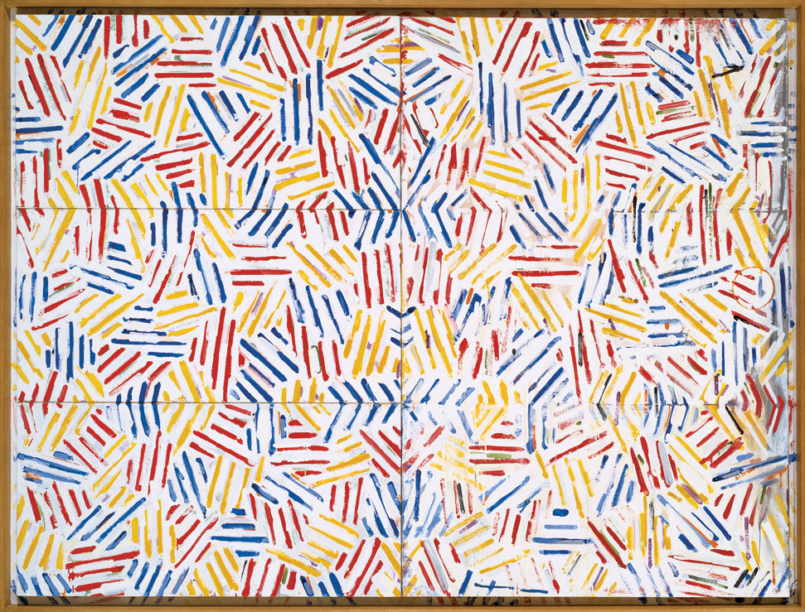
Art + Randomness
Jasper Jones

Slide 14
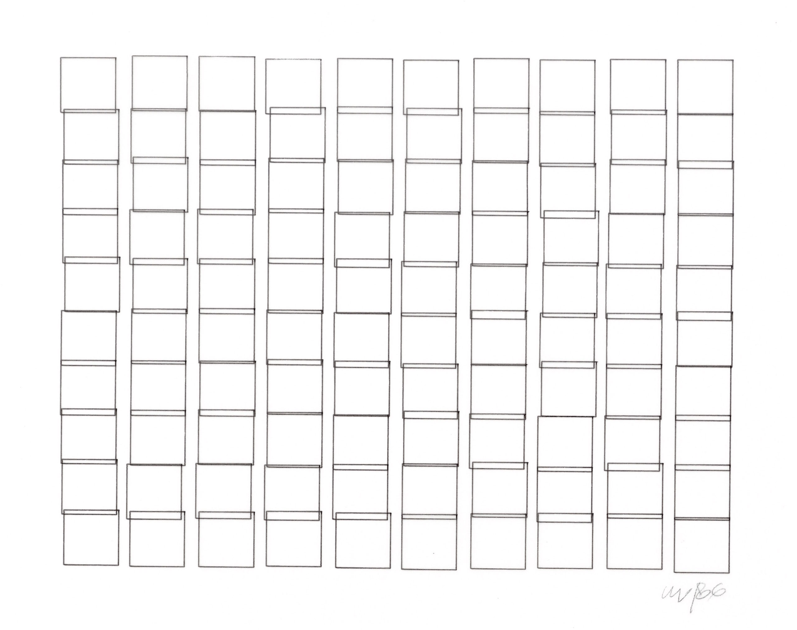
Try making this…
Vera Molnar

Slide 15
In-class exercise#3

